Slide 1
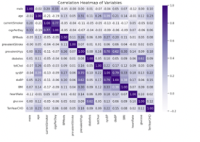
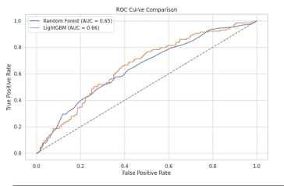
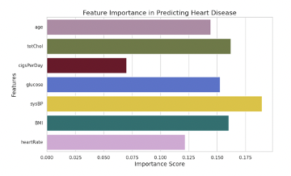
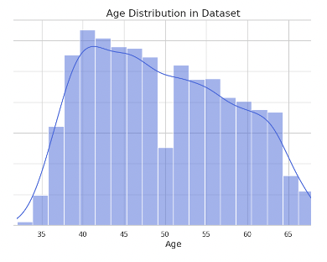
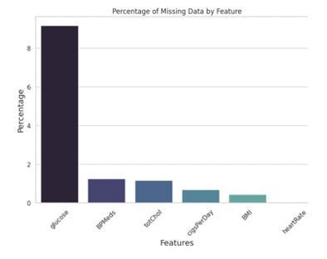
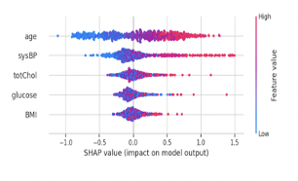
Heart Disease Prediction Model
Rahma Semma and Nishtha Sharma
Data Analytics Department, Dickinson College
Abstract
Methodology
Results
Conclusion
Heart disease remains a leading global cause of mortality. This project leverages machine learning to predict heart disease risk by analyzing the Framingham Heart Study dataset. Our primary goal is to identify key predictors such as age, cholesterol, and blood pressure and develop interpretable models that assist clinicians in making data-driven healthcare decisions. The study evaluates multiple models, emphasizing predictive accuracy and clinical relevance, while integrating SHAP (SHapley Additive exPlanations) for model transparency.
Data Preprocessing:
Missing values (12.74%) were handled by retaining glucose due to its clinical significance.
Standardization of features like age, cholesterol, and glucose was applied.
Feature Selection:
Recursive Feature Elimination (RFE) identified key predictors: age, cholesterol, glucose, systolic blood pressure, and smoking habits.
Model Development:
Trained Logistic Regression, Random Forest, Support Vector Machine (SVM), and LightGBM models.
Evaluation using AUC-ROC scores to measure predictive performance.
Model Interpretability:
SHAP was utilized to explain feature contributions to predictions, ensuring clinical alignment and interpretability.
1. Correlation Heatmap of Variables
Shows the pairwise correlations between features in the dataset.
Age (0.23) and Systolic Blood Pressure (sysBP) (0.22) have the highest positive correlation with the target variable TenYearCHD .
Features like glucose and cholesterol also show meaningful, though weaker, correlations.
Some features, such as cigsPerDay and currentSmoker, are strongly correlated (multicollinearity).
Objective: Develop a Disease Prediction Model using machine learning to predict disease risk.
Process:
Data preprocessing and exploratory analysis.
Model training and evaluation to ensure accuracy.
Emphasis on interpretability for clinical relevance.
Models Evaluated:
Logistic Regression, Random Forest, SVM, and LightGBM.
LightGBM performed best with an AUC-ROC score of 0.88, effectively handling complex data relationships.
Key Predictors Identified:
Age, Systolic Blood Pressure (sysBP), Cholesterol, and Glucose, aligning with known clinical risk factors.
Interpretability:
SHAP (Shapley Additive Explanations) explained how predictors influenced model predictions.
Impact:
Accurate and interpretable tool for identifying high-risk individuals.
Supports early intervention and improved healthcare decision-making.
Future Directions:
Expand model with additional features.
Integrate into clinical workflows for real-world applications.
2. Feature Importance in Predicting Heart Disease
This bar chart highlights the most important predictors of heart disease identified by the model.
Systolic Blood Pressure (sysBP) has the highest importance score, followed by Age, Total Cholesterol (totChol), and Glucose.
Features like BMI and Cigarettes Per Day (cigsPerDay) also contribute to the predictions.
Introduction
Why Heart Disease Prediction Matters:
Leading cause of global mortality with significant healthcare impacts.
Early detection saves lives and reduces healthcare costs.
Role of Machine Learning:
Identifies risk factors and predicts heart disease with advanced tools.
Enables data-driven, timely, and actionable clinical decisions.
Goals of the Project:
Predictive Models: Build models to estimate heart disease risk.
Key Indicators: Highlight critical factors like age, blood pressure, cholesterol, and glucose.
Clinical Interpretability: Provide interpretable outputs for better patient care integration.
3. Age Distribution in Dataset
This shows the age distribution of individuals in the dataset.
The majority of the data points fall within the 35–65 age range, with a peak around 45 years.
This indicates that middle-aged individuals dominate the dataset, which aligns with the observed higher risk of heart disease in this group.
The 6.35% young adults (under 45) at risk highlights the need for early screening.
4. SHAP Summary Plot
Age and Systolic Blood Pressure (sysBP) have the highest SHAP value spread, indicating their strong impact on increasing heart disease risk.
Positive SHAP values (in pink) signify an increased likelihood of heart disease, while negative SHAP values (in blue) lower the risk.
Features like Total Cholesterol (totChol) and Glucose also consistently influence the model's output.
Acknowledgements
We extend our gratitude to the Framingham Heart Study for providing the dataset and to the faculty at Dickinson College for their guidance. Special thanks to Professor Lulu Wang for their support and guidance for this research.

